Slide 1
Program
MineOperate Technical Overview
OP Pro
Technical Concepts
Edgar Sepulveda
Global Technical Manager, MineOperate
Date: 07/31/2023
Version: OP Pro 3.1-001

Slide 2

Purpose
This session introduces MineOperate portfolio technical concepts and shows how they work together to support MineOperate applications.
At the end of this module:
You will know what applications are part of the MineOperate portfolio.
You will know the different technologies used by MineOperate applications.
You will know MineOperate applications architecture.

Slide 3







HxGN Mining Product Portfolios
Explore
Plan
Produce
Operate
Extract
Consolidate

Slide 4
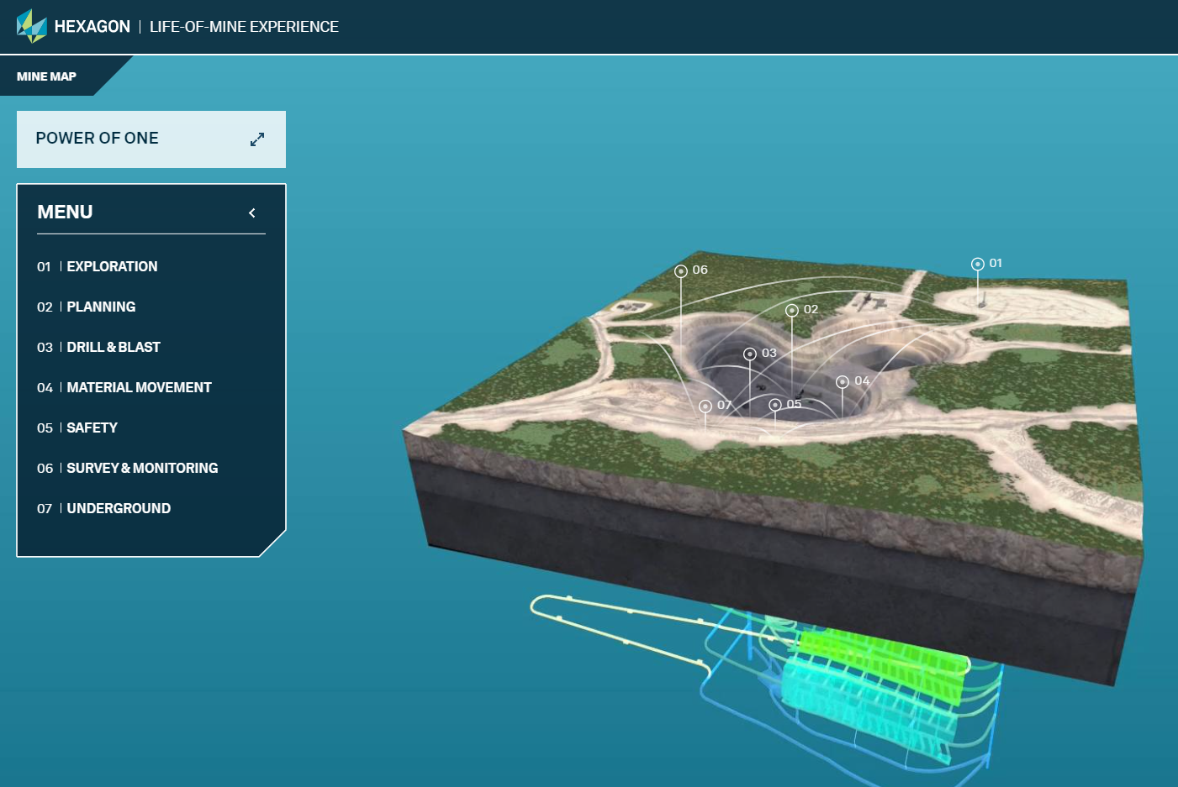
HxGN Mining Product Portfolios

Slide 5


Slide 6


HxGN MineOperate
Fleet Management
An open pit solution that helps managers track all their assets
Control the data from your systems, people and processes to maximize your mine’s productivity
Machine Guidance
A high-precision guidance solution for dozers, drills and loading equipment
Asset Health
A solution that enables maintenance and reliability by providing the data to review problems and take actions in real-time

Slide 7









MineOperate Applications
Drill
Blast
Load
Haul
Dump

Slide 8
MineOperate Applications
Fleet Management Field Equipment | Fleet Management Office | Machine Guidance | Machine & Asset Health
LP Truck | OP Pro Manager | HP Shovel | Asset Health
LP Shovel | Jview | HP Loader
LP Loader | MineEnterprise | HP Drill
LP Drill | Fleet Analytics 2.0 | HP Dozer
LP Dozer
LP Grader
LP Water Truck
LP Fuel Truck
LP Supervisor

Slide 9
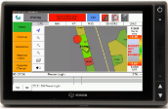


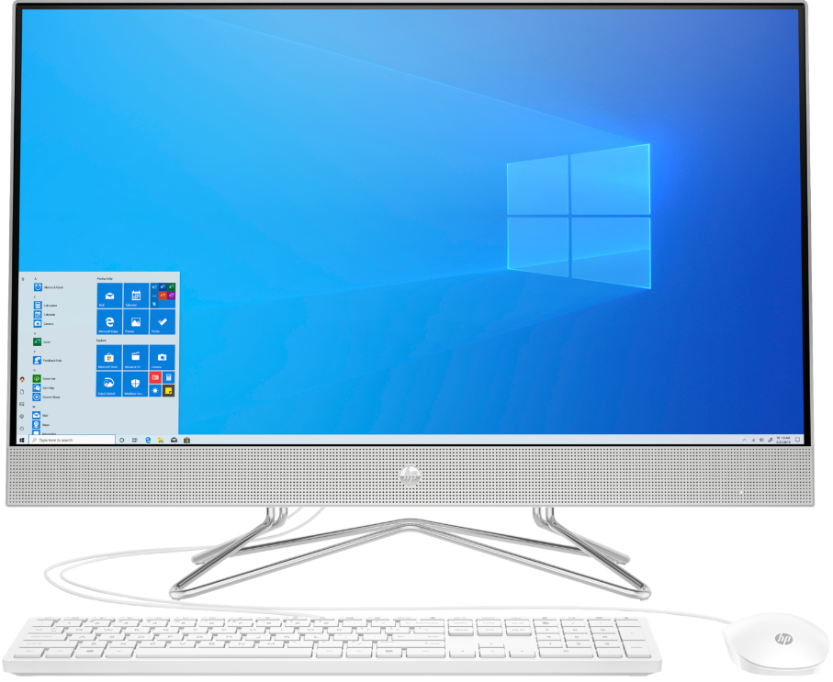

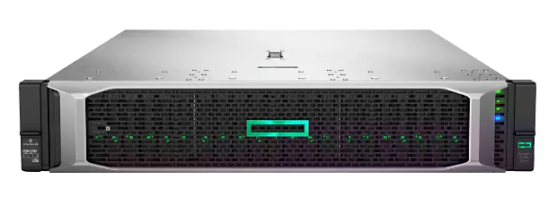
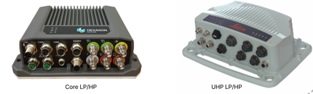

MineOperate Applications
JAMS
Office users
Reporting server
JAMS
Field equipment
HxGN MineOperate Asset Health
Application server
Application and data servers

Slide 10









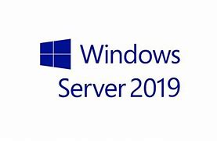


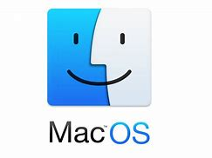


OP Pro Technologies
JAMS
JAMS

Slide 11
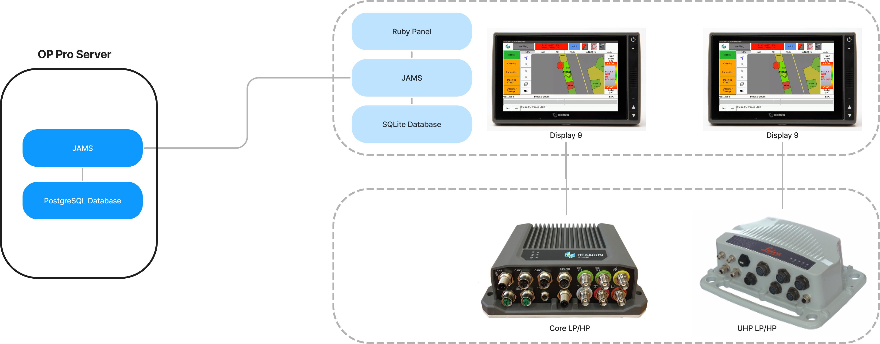


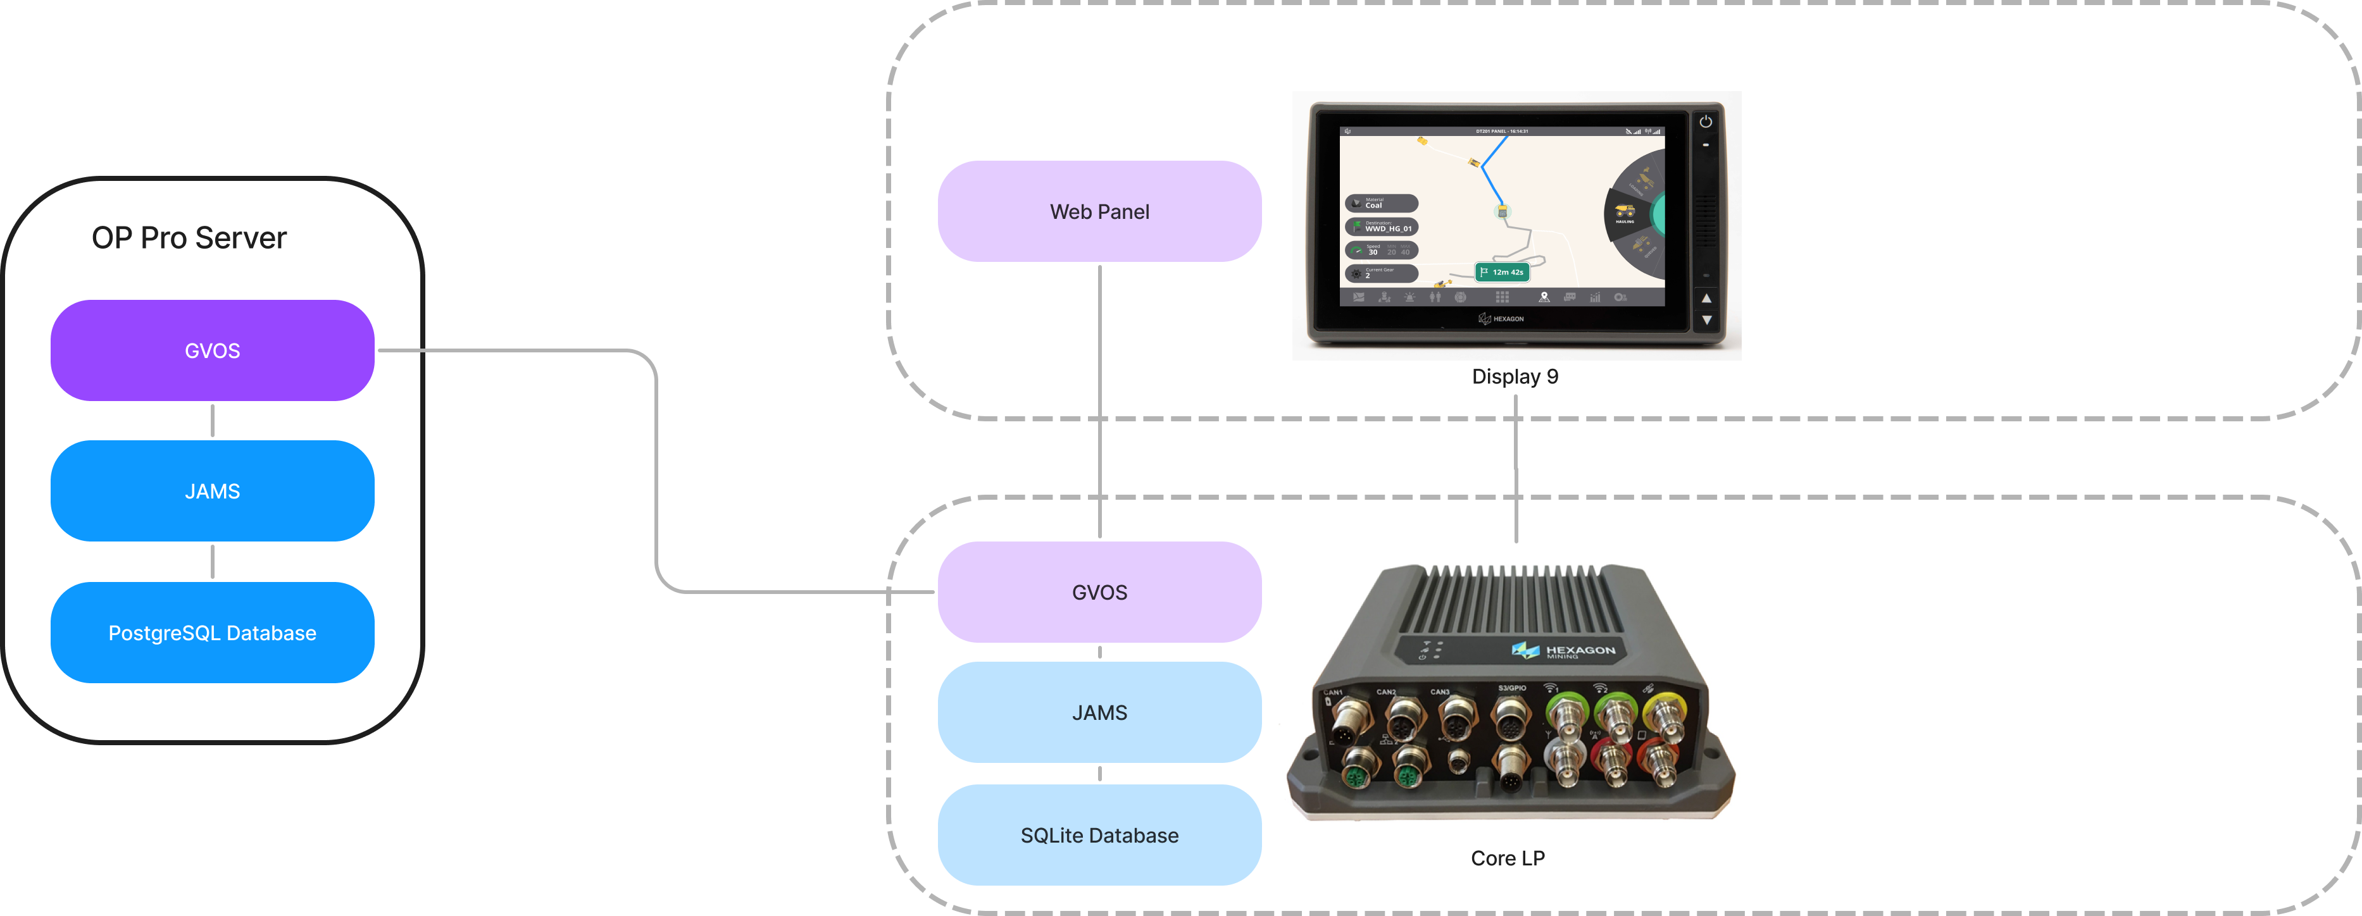
OP Pro Technologies

Slide 12
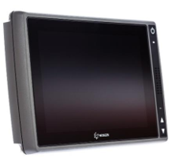

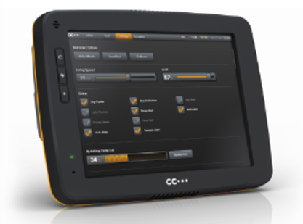
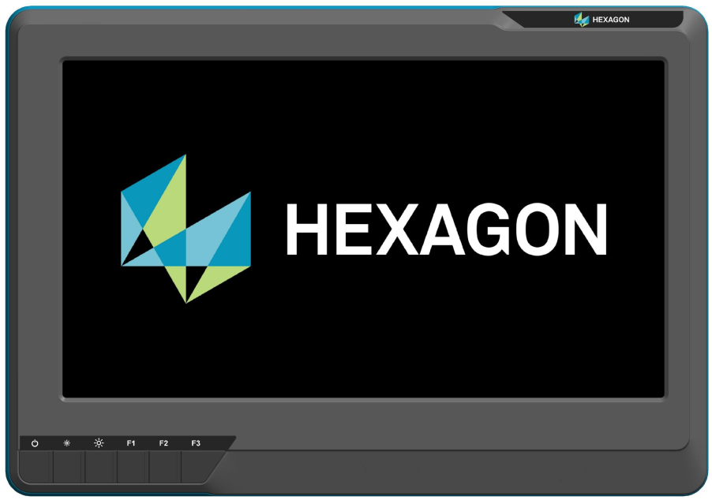
OP Pro Technologies
32 bits display
64 bits display
Display 9
X900
32 bits display
64 bits display
XM2
MP1225

Slide 13
OP Pro Technologies
32 bits display | 64 bits display | ruby panel | Web panel | Ubuntu | PostgreSQL | Core platform | Display platform | OP Pro
✓ |  | ✓ |  | 16.04 or 18.04 | 9.5 or 9.6 | 2.25.5 | 2.25.5 | 2.8-003

Slide 14
OP Pro Technologies
32 bits display | 64 bits display | ruby panel | Web panel | Ubuntu | PostgreSQL | Core platform | Display platform | OP Pro
✓ |  | ✓ |  | 16.04 or 18.04 | 9.5 or 9.6 | 2.25.5 | 2.25.5 | 2.8-003
✓ | ✓ | ✓ |  | 16.04 or 18.04 | 9.5 or 9.6 | 2.26.5 | MASEP 3.3.x | 2.8-005
Notes:
On June 30th, 2023, MASEP version 3.3.18

Slide 15
OP Pro Technologies
32 bits display | 64 bits display | ruby panel | Web panel | Ubuntu | PostgreSQL | Core platform | Display platform | OP Pro
✓ |  | ✓ |  | 16.04 or 18.04 | 9.5 or 9.6 | 2.25.5 | 2.25.5 | 2.8-003
✓ | ✓ | ✓ |  | 16.04 or 18.04 | 9.5 or 9.6 | 2.26.5 | MASEP 3.3.x | 2.8-005
✓ |  |  | ✓ | 20.04 | 12.6 | 2.26.5 | 2.26.5 | 3.0-002.012

Slide 16
OP Pro Technologies
32 bits display | 64 bits display | ruby panel | Web panel | Ubuntu | PostgreSQL | Core platform | Display platform | OP Pro
✓ |  | ✓ |  | 16.04 or 18.04 | 9.5 or 9.6 | 2.25.5 | 2.25.5 | 2.8-003
✓ | ✓ | ✓ |  | 16.04 or 18.04 | 9.5 or 9.6 | 2.26.5 | MASEP 3.3.x | 2.8-005
✓ |  |  | ✓ | 20.04 | 12.6 | 2.26.5 | 2.26.5 | 3.0-002.012
✓ | ✓ |  | ✓ | 20.04 | 12.6 | 2.26.5 | MASEP 3.3.x | 3.1-001

Slide 17
OP Pro Technologies
32 bits display | 64 bits display | ruby panel | Web panel | Ubuntu | PostgreSQL | Core platform | Display platform | OP Pro
✓ |  | ✓ |  | 16.04 or 18.04 | 9.5 or 9.6 | 2.25.5 | 2.25.5 | 2.8-003
✓ | ✓ | ✓ |  | 16.04 or 18.04 | 9.5 or 9.6 | 2.26.5 | MASEP 3.3.x | 2.8-005
✓ |  |  | ✓ | 20.04 | 12.6 | 2.26.5 | 2.26.5 | 3.0-002.012
✓ | ✓ |  | ✓ | 20.04 | 12.6 | 2.26.5 | MASEP 3.3.x | 3.1-001
 | ✓ | ✓ |  | 20.04 | 12.6

Slide 18
OP Pro Technologies
32 bits display | 64 bits display | ruby panel | Web panel | Ubuntu | PostgreSQL | Core platform | Display platform | OP Pro
✓ |  | ✓ |  | 16.04 or 18.04 | 9.5 or 9.6 | 2.25.5 | 2.25.5 | 2.8-003
✓ | ✓ | ✓ |  | 16.04 or 18.04 | 9.5 or 9.6 | 2.26.5 | MASEP 3.3.x | 2.8-005
✓ |  |  | ✓ | 20.04 | 12.6 | 2.26.5 | 2.26.5 | 3.0-002.012
✓ | ✓ |  | ✓ | 20.04 | 12.6 | 2.26.5 | MASEP 3.3.x | 3.1-001
 | ✓ | ✓ |  | 20.04 | 12.6 | 2.26.5 | MASEP 3.3.x | 2.8-005 3.1-001

Slide 19
OP Pro Technologies
32 bits display | 64 bits display | ruby panel | Web panel | Ubuntu | PostgreSQL | Core Platform | Display Platform | OP Pro
✓ |  | ✓ |  | 16.04 or 18.04 | 9.5 or 9.6 | 2.25.5 | 2.25.5 | 2.8-003
✓ | ✓ | ✓ |  | 16.04 or 18.04 | 9.5 or 9.6 | 2.26.5 | MASEP 3.3.x | 2.8-005
✓ |  |  | ✓ | 20.04 | 12.6 | 2.26.5 | 2.26.5 | 3.0-002.012
✓ | ✓ |  | ✓ | 20.04 | 12.6 | 2.26.5 | MASEP 3.3.x | 3.1-001
 | ✓ | ✓ |  | 20.04 | 12.6 | 2.26.5 | MASEP 3.3.x | 2.8-005 3.1-001
 | ✓ | ✓ |  | 20.04 | 9.6 | 2.26.5 | MASEP 3.3.x | 2.8-005

Slide 20
OP Pro Technologies

Slide 21
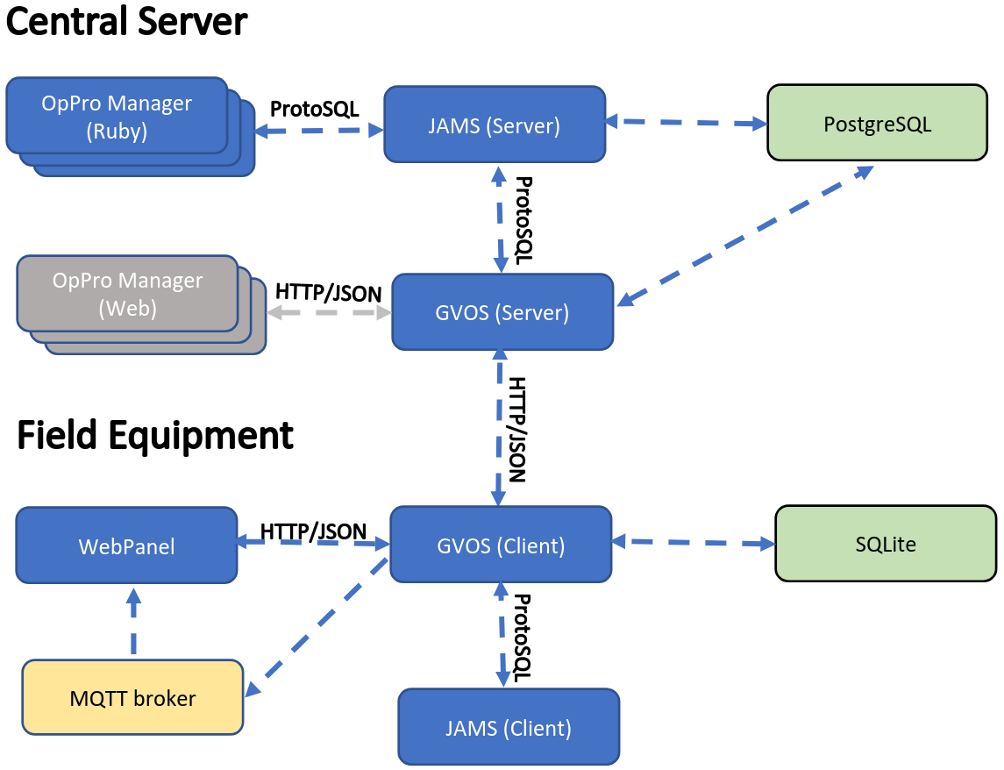
OP Pro Technologies

Slide 22
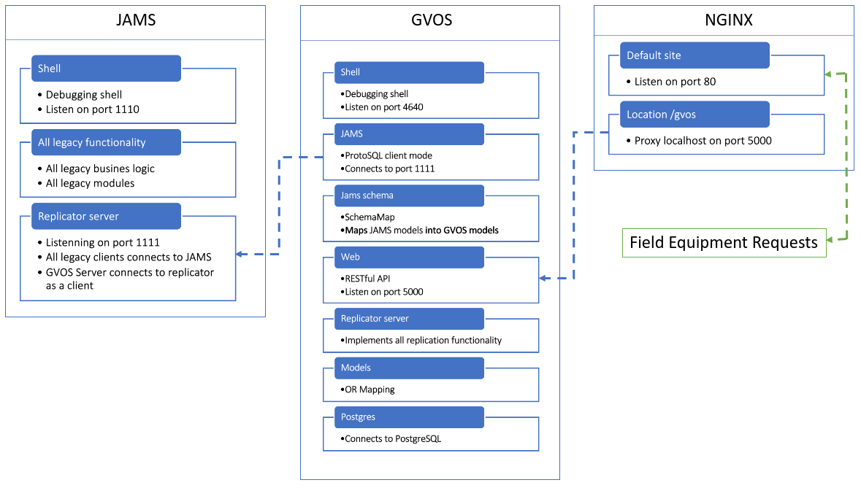
OP Pro Technologies

Slide 23
OP Pro Technologies
GVOS/JAMS Integration
GVOS and JAMS has been integrated so they can run alongside each other on an Ubuntu server.
Both GVOS and JAMS run as replicator servers where:
GVOS serves as the replicator for all OAS devices (including the devices that are running the GVOS/JAMS integration for the new React panel).
JAMS serves as replicator server for all legacy JAMS equipment and OP Pro Manager clients.
GVOS and JAMS connect to the same PostgreSQL database which uses JAMS schema.

Slide 24
OP Pro Technologies
Schema mapping
While the schemas for GVOS and JIGSAW databases have mostly been merged, there are some key differences in some tables and columns names that require translation between the two systems.
The PostgreSQL database on the server uses the JIGSAW database schema with the GVOS schema merged into it.
The sqlite database onboard the equipment uses the GVOS database schema with the JIGSAW schema merged into it.
The mapping between databases schemas is handled by GVOS on the server and onboard by parsing database queries and applying the relevant schema mapping to form the correct query.

Slide 25
OP Pro Technologies
GvWeb
The GVOS REST API is contained in the GvWeb module, GvWeb listens on port 5000 for incoming HTTP requests.
GvWeb can be used to query model schema, query model data and invoke GVOS methods remotely.
Some examples:
To retrieve information about the schema of the model:
http://localhost/gvos/schema/<Model Name>
http://localhost/gvos/schema/GvEquipment
To retrieve all records for the model in JSON format:
http://localhost/gvos/object/<Model Name>
http://localhost/gvos/object/GvEquipment

Slide 26
OP Pro Technologies
Nginx
A nginx server should be configured to listen on port 80 and forward all requests with the ‘/gvos/’ path to GvWeb.
Replicator
The GVOS replicator serves updates to clients over HTTP.
The clients connect to server utilizing the REST API on port 80.
When running alongside JAMS, the GVOS server uses the replicas_oas table instead the replicas table to load the replicas configurations.
The JAMS scheme mapping is also used when equipment upload data to the server to map it from GVOS schema to the JIGSAW schema before it is stored in the database.

Slide 27
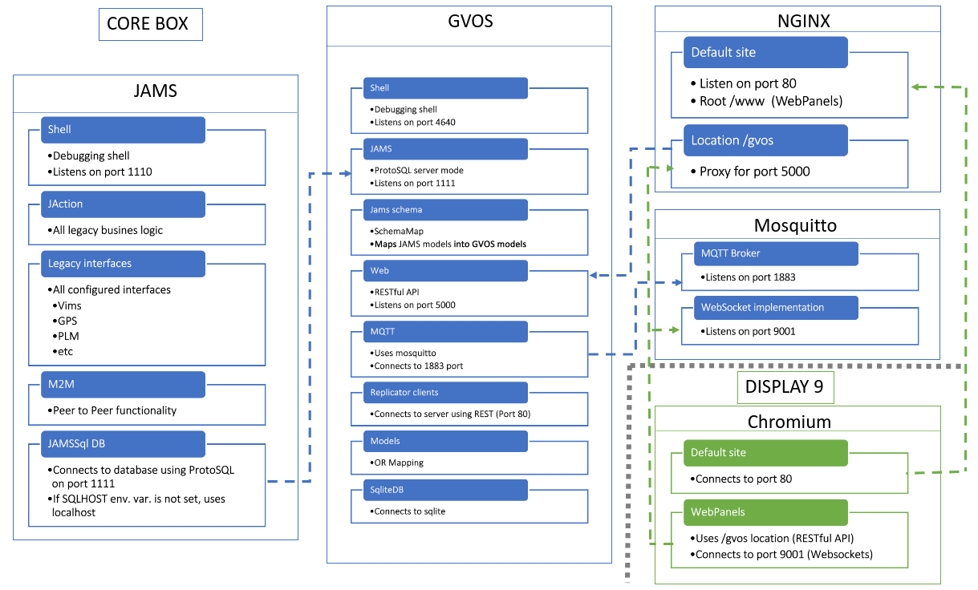
OP Pro Technologies

Slide 28
OP Pro Technologies
JAMS Interface
Schema mapping
GvWeb
GvMQTT
The GVMQTT module handle subscribing to notifications for model updates and log messages. In order to enable GVOS to publish updates for a table or log, you must publish a message to one of the following topics:
gvos/<DEVICE>/logs/listen
gvos/<DEVICE>/models/listen
gvos/<DEVICE>/sensors/listen
gvos/<DEVICE>/signals/listen
mosquitto_pub –h localhost –p 1883 –t ‘gvos/T072/models/listen’ –m ‘JsTruck’

Slide 29
OP Pro Technologies
Log files
The GVOS log files are stores in the /opt/oas/logs directory.
When JAMS is running alongside GVOS, the JAMS logs are also stored in the /opt/oas/logs directory.
Note that /opt/Jigsaw/Logs directory will still contain the messages log file.
To enable logs, connect to Core box of the equipment that you are debugging and start a telnet session on port 4640 to access the gvos shell (telnet localhost 4640). Once connected to the gvos shell enter:
listen <logname>
mqtt, replicator, jams, web

Slide 30
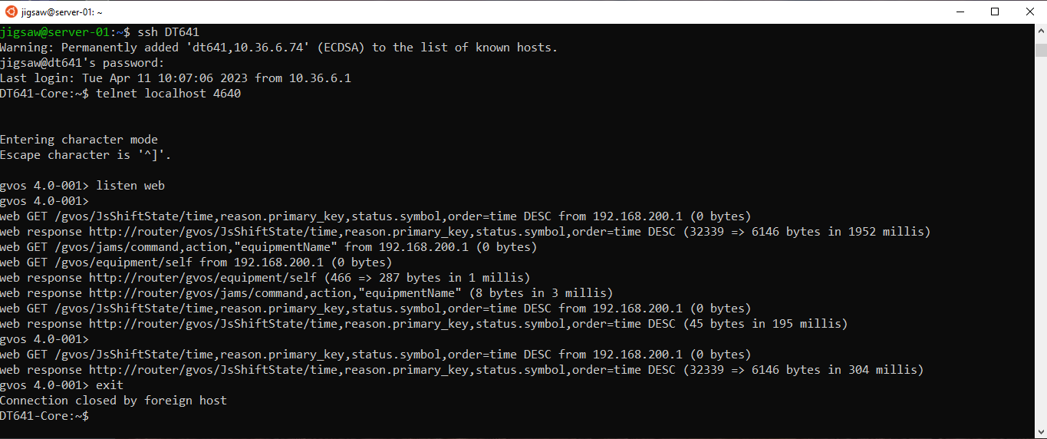
OP Pro Technologies

Slide 31
OP Pro Technologies
Time synchronization
Core box uses Chrony for managing ntp. The configuration for chrony can be found on /etc/chrony.conf
Display9 uses ntpd for managing ntp. The configuration for ntpd can be found at /etc/ntp.conf

Slide 32
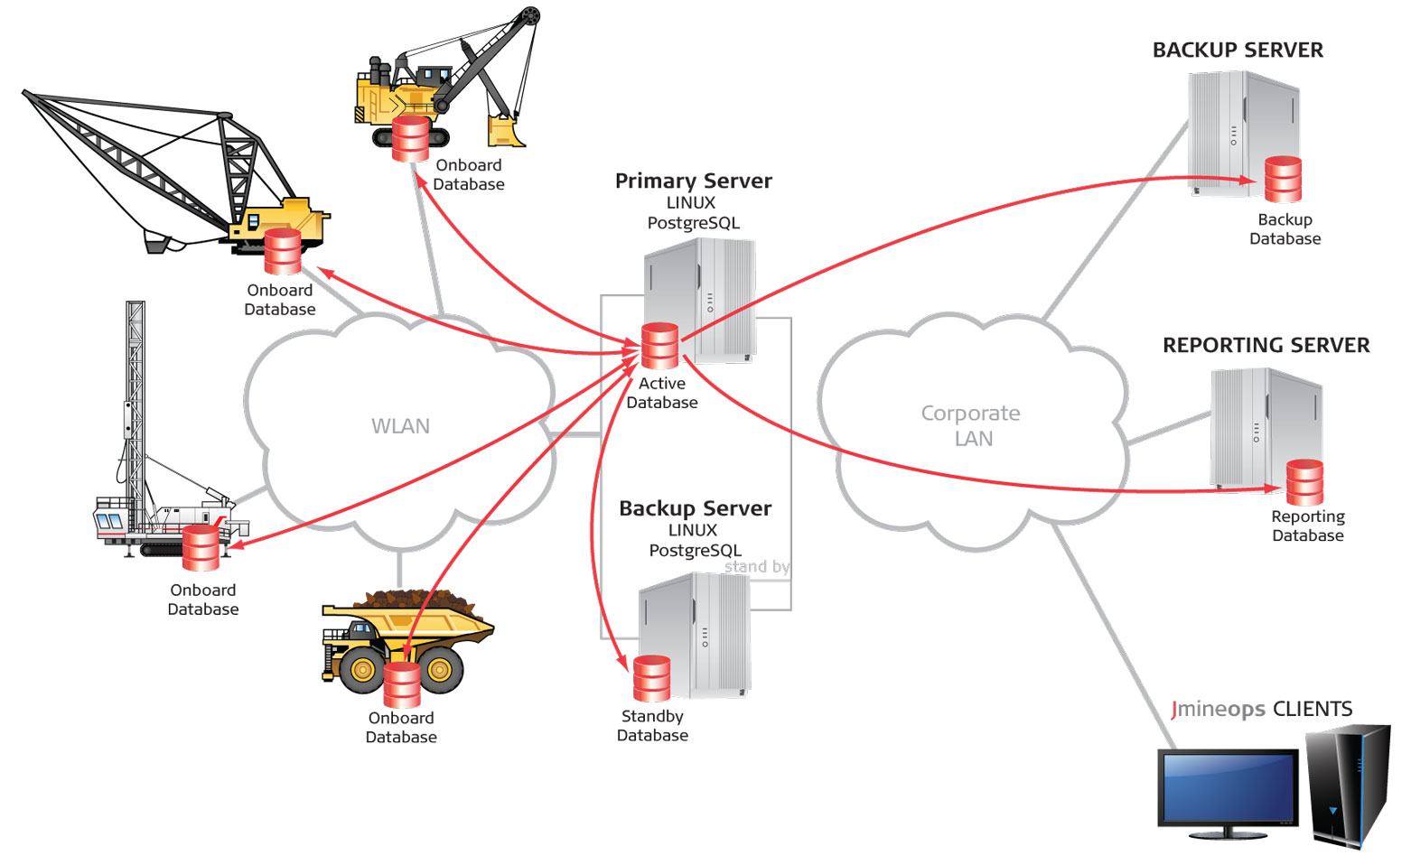
OP Pro System Architecture
OP Pro Application Servers: Hosts JAMS processes and services.
Wireless Network: 802.11 network to communicate with field equipment.
Corporate Network: Provides access to office users.
Reporting Server: Business Intelligence and replicated reporting database.

Slide 33
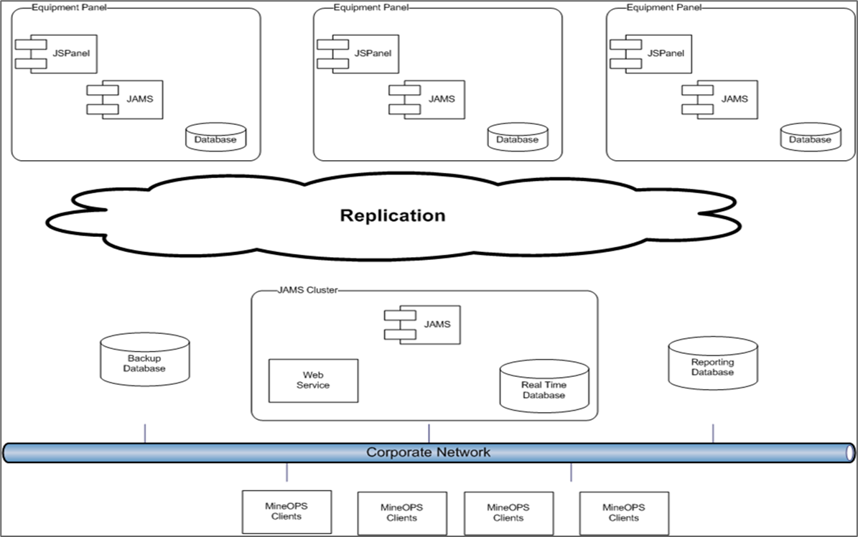
OP Pro System Architecture
Replication

Slide 34
OP Pro System Architecture
JAMS application
JAMS is installed in OP Pro application servers and field equipment.
JAMS software running on board is the key element that allows the hubs to interact with the central OP Pro server.
JAMS handles all replication and controls which actions are taking place when and where. It responds to the environment the equipment operates in and is critical to the operation of the unit.
If there is an issue with JAMS, the entire unit will be affected.
Reconciler - Series of PostgreSQL functions that run to clean up records/data (reconcile data).
Summarizer – Script to create records in summary tables based in the historical data.

Slide 35
OP Pro System Architecture
Communications
Office users communication
Office PCs communicate with the OP Pro Server across the standard wired network.
FMS communication
All communication between the field equipment and the OP Pro Server occurs across a Virtual Private Network (VPN) tunnel between the OP Pro Server and the field equipment.
OpenVPN
An OpenVPN service runs on the OP Pro server, which creates a virtual tunnel adapter with a specific IP address with which all field equipment can communicate on. OpenVPN uses OpenSSL, which provides a secure means for field equipment to communicate with the OP Pro server.

Slide 36
OP Pro System Architecture
Connections
JAMS
All field equipment and office PC clients communicate through a TCP socket on port 1111 to the JAMS Service running on the OP Pro Server.
Field Equipment
All OP Pro field equipment resides on a particular subnet and all network traffic is routed across a VPN tunnel to the OP Pro Server.
OP Pro Manager Clients
All OP Pro Manager Clients communicate with the OP Pro server across the standard wired network.
rsync
A rsync daemon is run on the OP Pro server and is used to distribute new software to field equipment. When an administrator updates the software version for field equipment, the onboard JAMS runs rsync to copy the relevant files from the OP Pro server.

Slide 37
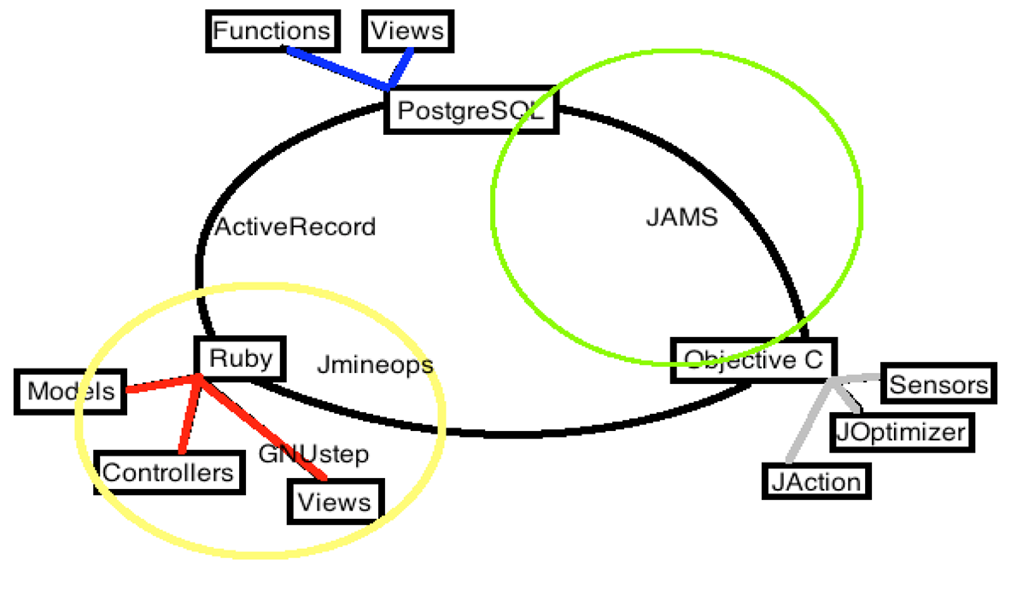
OP Pro System Architecture
Software development

Slide 38

Thank you.
Notes:
Thank you.

Slide 39
OP Pro Technical Concepts - Questions
True or False OP Pro application server hosts JAMS.
True or False Corporate network provides access to field equipment.
True or False Replication is one of the main JAMS processes to send data between office users and application server.
Which of the following options are initiated by JAMSCluster:
JAMSRouter
OpenVPN
rsync
JAMSGateway
All the above
True or False Model-View-Controller MVC software design patter is used in Jpanel application.

Slide 40
OP Pro Technical Concepts - Answers to Questions
True or False OP Pro application server hosts JAMS. True
True or False Corporate network provides access to field equipment. False
True or False Replication is one of the main JAMS processes to send data between office users and application server. False
Which of the following options are initiated by JAMSCluster:
JAMSRouter
OpenVPN
rsync
JAMSGateway
All the above
True or False Model-View-Controller MVC software design patter is used in Jpanel application. False

Slide 41
OP Pro Technical Concepts - Questions
Which of the following options are new Hexagon technologies:
32 bits displays and Web panels
32 bits displays and ruby panels
64 bits displays and Web panels
64 bits displays and ruby panels
True or False X900 is the new 64 bits display use on OP Pro HP field equipment.
True or False Web panels only run on X900 displays using OP Pro version 3.x-00x.
True or False JAMS, GVOS, Mosquitto and nginx are installed in display when using new 64 bits displays.
True or False Web panels connects to Websockets on port 9001.

Slide 42
OP Pro Technical Concepts - Answers to Questions
Which of the following options are new Hexagon technologies:
32 bits displays and Web panels
32 bits displays and ruby panels
64 bits displays and Web panels
64 bits displays and ruby panels
Option c is the right answer.
True or False X900 is the new 64 bits display use on OP Pro HP field equipment. False. X900 are used on LP field equipment, MP1225 displays are use on HP field equipment.
True or False Web panels only run on X900 displays using OP Pro version 3.x-00x. False. Web panels can run on 32 bits and 64 bits displays using OP Pro version 3.x-00x.
True or False JAMS, GVOS, MQTT and NGINX are installed in Core box when using new 64 bits displays. True
True or False Web panels connects to Websockets on port 9001. True

